Slide 1

Using Machine & Deep Learning to Predict Fuel Consumption in Hydrogen Fuel Cell Electric Vehicle ID: 60706 Name: Kokosalakis Nick

Slide 2

Introduction
Hydrogen is a Zero-Emission Fuel: Hydrogen is emerging as one of the most promising fuels for the transition to clean transportation.
But:
1) It does not exist freely in nature
2) It must necessarily be produced from compounds that contain it
3) The production of hydrogen currently involves significant technical and economic challenges

Slide 3
Board of Hydrogen Production with Advantages and Disadvantages
Energy Sources | Production Methods | Environmental Impact | +Advantages | -Disadvantages
Water & RES (Renewables) | Electrolysis (using solar & wind energy) | Zero emissions | Absolutely clean Ideal for the climate | Very energy-intensive High cost
Biomass – Waste | Thermochemical & biological processes | Renewable due to biological materials | Utilizes waste Supports bioeconomy | Complex processes Unstable efficiency
RES (indirectly) | Renewable energy-powered electrolysis | Clean | Compatible with green electricity grid | Intermittent energy Requires energy storage
Natural Gas | Steam Methane Reforming (SMR) | CO₂ emissions (or partial capture) | Cheap technology | Unsustainable Polluting Fossil fuel-based
Coal – Lignite | Gasification | Highly polluting | High production volume | Severe emissions Outdated technology
Oil – Synthetic fuels | Pyrolysis – Thermal decomposition | Quite polluting | Existing infrastructure | Toxic residues CO₂ emissions
Nuclear Energy | Electrolysis using nuclear energy | Low emissions but with nuclear waste | Stable energy supply Low CO₂ | Nuclear waste High cost

Slide 4
Hydrogen Use in Electric Vehicles
Fuel Cell Electric Vehicles (FCEVs):
- Converting hydrogen into electric energy to power the wheels
- Used in passenger cars, trucks, buses, and trains
- Hydrogen is stored in tanks and it supplies the fuel cells, which are connected to electric motor and an auxiliary battery.

Slide 5
FCHEVs – Advantages & Disadvantages
FCHEVs – Advantages & Disadvantages
Advantages | Disadvantages
Zero pollutant emissions (only water vapor) | High production and purchase cost for the fuel cell and storage tanks
Fast refueling (3 to 5 minutes) | More complex system compared to BEVs (fuel cell, tanks, battery)
Long driving range (500–700+ km), especially in heavy-duty vehicles | Limited refueling infrastructure (very few hydrogen stations)
Stable performance in all temperatures | Hydrogen production is energy-intensive (green H₂ = expensive)
Lighter than Battery Electric Vehicles in heavy-duty applications (trucks, trains, buses) | Requires a battery as well – adds cost and maintenance
Enable energy recovery (regenerative braking) | Hydrogen production is currently polluting (unless fully green)
Suitable for frequent and intensive use (taxis, logistics, public transport) | Currently limited expertise and availability for service/maintenance

Slide 6
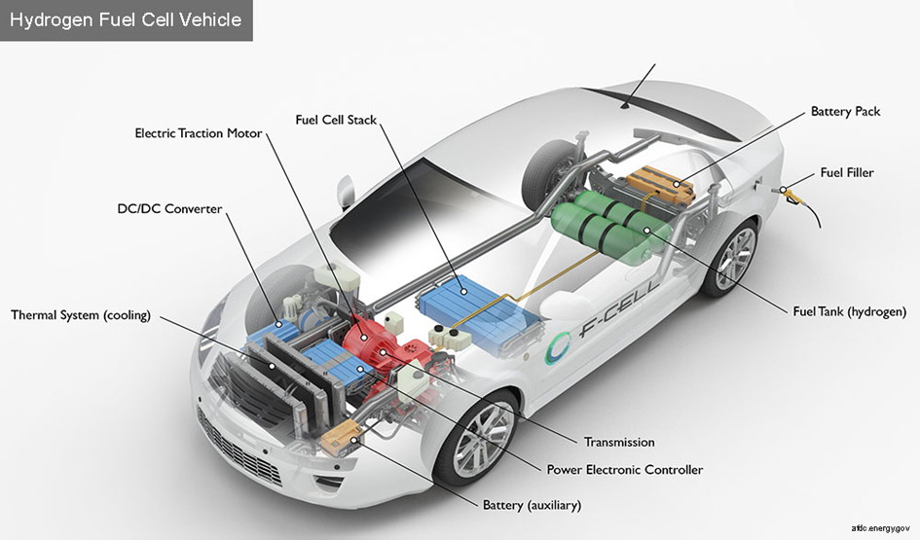
Example of a Fuel Cell Electric Vehicle (FCEV) Anatomy

Slide 7
Example of a Fuel Cell Electric Vehicle (FCEV) Anatomy
1) Fuel Cell Stack: Converts the hydrogen into electrical energy through an electrochemical reaction with oxygen.
2) Fuel Tank (hydrogen): Stores the hydrogen under high pressure
3) Fuel Filler: Is Hydrogen refueling point
4) Battery Pack: Is the supplementary energy storage for increased demands (e.g., acceleration)
5) Electric Traction Motor: The Electric motor that powers the vehicle
6) DC/DC Converter: Regulates the voltage between components (fuel cells – batteries – motor)
7) Thermal System (Cooling): Maintains the optimal operating temperature across all subsystems
8) Transmission: Transfers the motion to the wheels
9) Power Electronic Controller: Manages the power and motor control
10) Battery (Auxiliary): Powers the auxiliary systems (lights, infotainment, etc)

Slide 8
The role of Artificial Inteligence
Machine Learning & Deep Learning can:
1)Accurately predict the hydrogen consumption based on load, speed, slope, and other data.
2)Optimize real-time usage between the fuel cell and the battery
3)Minimize losses and extend the lifespan of both the fuel cell and the battery
4)Contribute to “intelligent” Energy Management Systems (EMS), thereby reducing the overall need for hydrogen production

Slide 9
Literature Review
The selected articles all aim to optimize the hydrogen consumption through intelligent control or prediction.
Simulations or real driving cycles are used to train the Machine Learning (ML) and Deep Learning (DL) models.
Emphasis is placed on the energy management, the dynamic response and the system adaptability.
Some models are trained based on some optimal strategies derived from Dynamic Programming, while others rely on Reinforcement or Supervised Learning.

Slide 10
Deep reinforcement learning-based health-conscious energy management for fuel cell hybrid electric vehicles in model predictive control framework
Scientists: Xuejin Huang a, Jingyi Zhang b, Kai Ou c,**, Yin Huang a, Zehao Kang a, Xuping Mao a,Yujie Zhou a, Dongji Xuan a
To address the above research gap the present study focuses on model-based deep reinforcement learning (DRL) and proposes an intelligent energy management system (EMS) centered on maintaining the "health" of the system, combining the Model Predictive Control (MPC) framework with DRL.

Slide 11
DATA THAT USED FOR TEST AND TRAINING
The paper uses data from the simulations and the standard driving cycles to train the DRL and Bi-LSTM models.
For the speed prediction using the Bi-LSTM model:
The following driving cycles were used as training data: WVUSUB, NYCC, US06, EUDC, and LA92.
For test data: they used the UDDS (Urban Dynamometer Driving Schedule)
The names which are mentioned above refer to standardized driving cycles that are internationally used in research and simulations to represent typical traffic conditions, aiming to evaluate fuel consumption, emissions, and the vehicle performance.

Slide 12
STANDARD DRIVING CYCLES FOR TEST ANS TRAINING
Cycle | Region / Description | Characteristics
UDDS (Urban Dynamometer Driving Schedule) | Urban traffic in the USA | Many stops and low speeds – Used as a test set
WVUSUB (West Virginia Suburban Driving Schedule) | Suburban driving | Alternating low/medium speeds with uphill/downhill segments
NYCC (New York City Cycle) | Traffic in Manhattan | Many stops, low speeds, heavy congestion
US06 | Part of the SFTP (Supplemental Federal Test Procedure) | High speed + aggressive acceleration – more "realistic"
EUDC (Extra Urban Driving Cycle) | European suburban driving | Faster than NEDC, includes acceleration/deceleration phases
LA92 (Los Angeles 1992 Cycle) | Traffic in Los Angeles | Based on real-world data, more "fluid" than UDDS

Slide 13
HOW THEY TRAINED THEIR MODELS
The DRL models (DQN, DDPG, TD3) and the proposed MPC-DRL were trained in MATLAB/Simulink simulations by using the same driving cycles for comparability purposes.
No real vehicle data was used.
The training was conducted under simulated FCHEV operating conditions.
This supports the study’s validity for research purposes but also indicates that the models have not yet been evaluated using real-world traffic data.

Slide 14
TEST DATA
1) The UDDS (Urban Dynamometer Driving Schedule) cycle was used as test data.
2) The DRL models (DQN, DDPG, TD3) and the proposed MPC-DRL were trained in simulations in MATLAB/Simulink, using the same cycles for comparability purposes.
3) No real-world vehicle data were used. All training was conducted using simulated operating conditions of the FCHEV system.
4) This supports the validity of the study for research purposes, but it shows that the models have not yet been evaluated on real-world driving data.

Slide 15
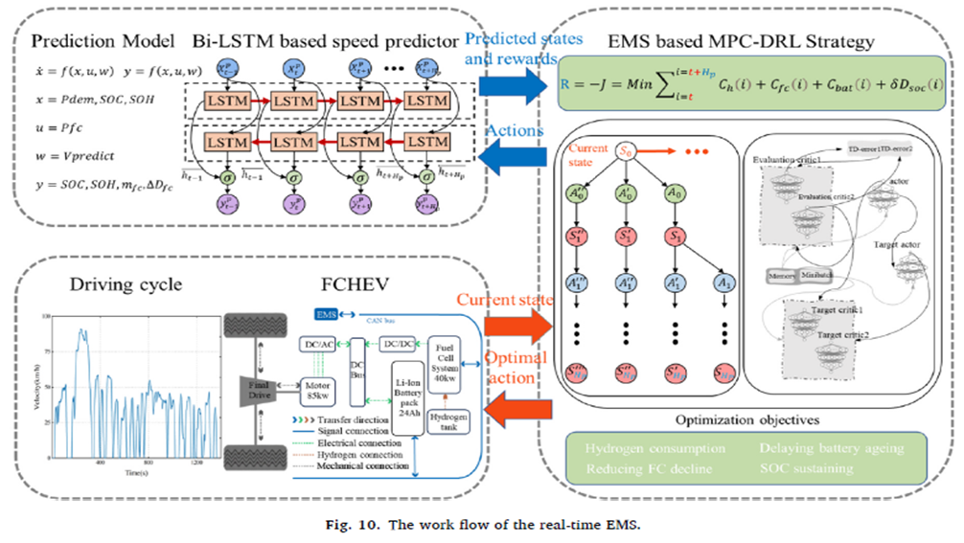
SYSTEM WORKFLOW

Slide 16
SYSTEM WORKFLOW
The image shows how they are combined:
Speed prediction (Bi-LSTM)
Vehicle power system (FCHEV)
3) Intelligent energy management (MPC–DRL)
To enable real-time optimal decisions with the aim of hydrogen saving, system protection, and performance maximization.

Slide 17
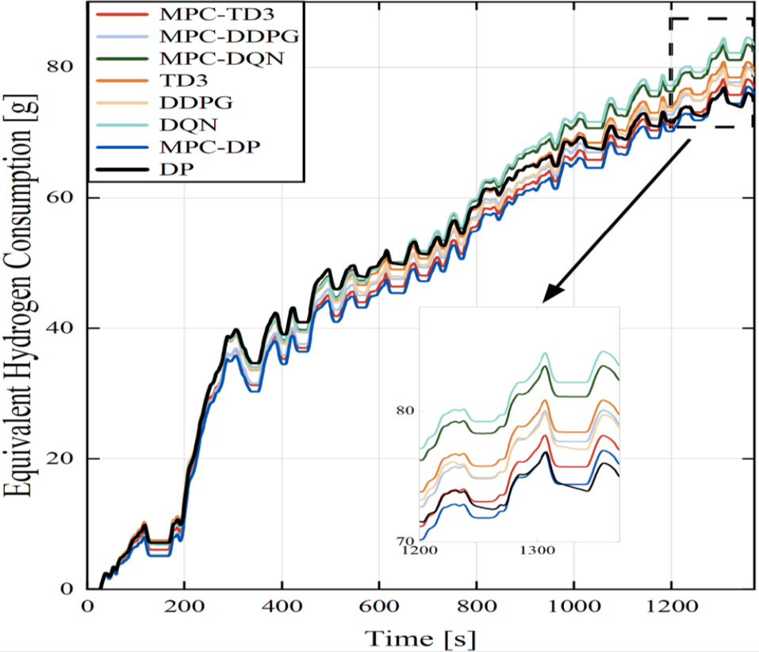
COMPARISON OF THE ALGORITHMS

Slide 18
COMPARISON OF THE ALGORITHMS
The diagram compares 8 different EMS methods:
Category | Method | Description
DRL | DQN, DDPG, TD3 | Deep learning without MPC
MPC-DRL | MPC-DQN, MPC-DDPG, MPC-TD3 | DRL integrated to an MPC framework
Benchmark | DP (Dynamic Programming), MPC-DP | Classical Benchmark Methods

Slide 19
CONCLUSION
The MPC-TD3 method achieves reduced hydrogen consumption compared to the plain DRL models and approaches the performance of Dynamic Programming, demonstrating the optimal balance between intelligent control and consumption.

Slide 20
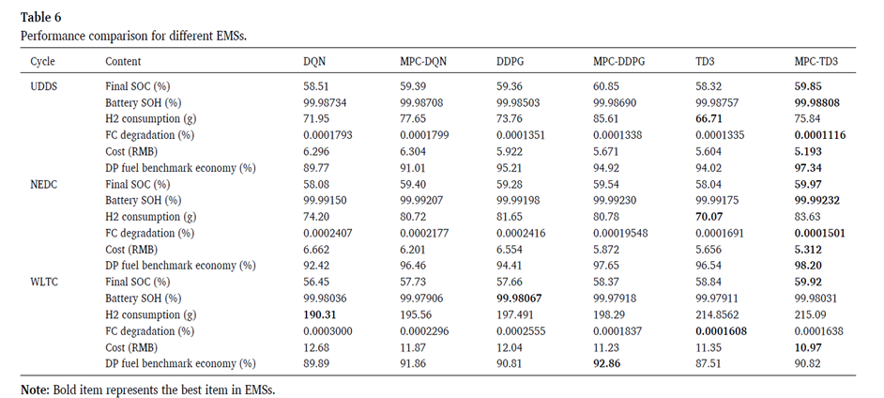
PERFORMANCE COMPARISON OF DIFFERENT EMSs

Slide 21
PERFORMANCE COMPARISON OF DIFFERENT EMSs
What the above table tells us: The MPC-TD3 algorithm consistently shows the best performance, achieving:
Lower hydrogen consumption
Reduced fuel cell and battery degradation
Lower overall cost
High level of approximation of the optimal DP strategy

Slide 22
PERFORMANCE COMPARISON OF DIFFERENT EMSs
Indicator | Best result
H₂ Consumption (lower) | MPC-TD3 in UDDS & NEDC; TD3 in WLTC
FC Degradation (lower) | MPC-TD3 and MPC-DDPG
Battery SOH (higher) | MPC-TD3 (NEDC) / MPC-DDPG (WLTC)
Final SOC | MPC-DDPG (UDDS) / MPC-TD3 (NEDC)
Cost (lower) | MPC-TD3 in all cycles
Savings compared to DP (%) | MPC-TD3 or MPC-DQN, but DP still remains the benchmark

Slide 23
A controllable neural network-based method for optimal energy management of fuel cell hybrid electric vehicles
Scientists: Bo Liu , Xiaodong Wei , Chao Sun , Bo Wang , Weiwei Huo
This paper proposes a flexible and controllable neural network-based energy management strategy for fuel cell hybrid electric vehicles. By introducing an adjustable target variable inspired by the ECMS approach, the proposed method enables real-time control and adaptation to varying driving conditions. Simulation results show that the shooting neural classifier achieves 99.7% fuel optimality of dynamic programming, while the adaptive classifier outperforms the adaptive ECMS in fuel economy across different scenarios.

Slide 24
DATA THAT THEY USED FOR TEST AND TRAINING
The data were derived from Dynamic Programming (DP) optimization on 15 standardized driving cycles, including:
1) CCBC – China City Bus Cycle
2) CHTC-B/C – Chinese cycles for heavy vehicles
3) CLTC-C / CLTC-P – China Light-duty Commercial & Passenger
4) HWFET – Highway Fuel Economy Test
5) JE05 / JP1015 – Japanese cycles
6) NYCC / MBC – New York City, Manhattan Bus
7) WLTC-1/2/3a – Worldwide Harmonized Light Vehicles Test Cycles (WLTC)
7) WVUCITY / WVUSUB – Cycles from West Virginia University
The data encompass urban, suburban, and highway conditions, realistically covering diverse driving profiles.

Slide 25
HOW THEY CREATE THE DATASET
A vehicle FCHEV model in ADVISOR (MATLAB/Simulink) was used.
The optimal consumption strategy for each cycle was determined using DP.
The results (SoC, Power Demand, Target SoC, etc.) were stored as input/output sets for neural network (MLP) training.
Training/Test split:A 3:1 split of the data for training/testing.
Five cycles (CLTC-P, FTP-72, NEDC, C–CFN, RealDC) were used for the final evaluation.

Slide 26
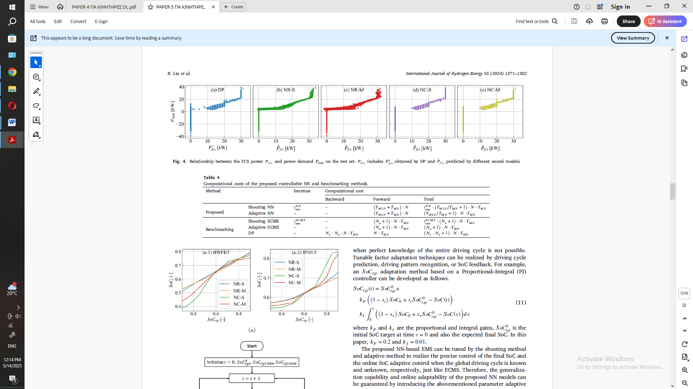
COMPARISON OF THE MODELS

Slide 27
COMPARISON OF THE MODELS
Figure 4 shows the relationship between the power produced by the fuel cell and the power demand in the test set for various prediction models based on neural networks (NNs), as well as the Dynamic Programming (DP) method for comparison.
Figure 4 shows that the proposed shooting classifier NC-M has the best power prediction among all the NN models, reaching the accuracy of Dynamic Programming. This confirms the capability of controlling the final state with an intelligent neural system.

Slide 28
COMPARISON OF THE MODELS

Slide 29
COMPARISON OF THE MODELS
What (a-1) and (a-2) show:
These illustrate the accuracy of controlling the final SoC (State of Charge) of the battery for different neural EMS models, across two driving cycles:(a-1): HWFET (Highway Fuel Economy Test) cycle(a-2): JP1015 (Japanese low-speed cycle)
What the axes show:
Horizontal axis (x): SoC => target final state of charge
Vertical axis (y): SoC => actual final state of charge after the cycleIdeally, points should lie on the diagonal (y = x), meaning the model perfectly reached the target.

Slide 30
COMPARISON OF THE MODELS
What they are compared:
Abbreviation | Method
NR-S | Neural Regression – Simple (no shooting)
NR-M | Neural Regression – Modified (with SoC targeting)
NC-S | Neural Classifier – Simple
NC-M | Neural Classifier – Modified (proposed shooting classifier)

Slide 31
COMPARISON OF THE MODELS
Conclusions for each diagram:
1) (a-1) HWFET: All models perform quite well.
The NC-M (red line) aligns very closely with the diagonal.
The NC-S significantly deviates at low SoC.
2) (a-2) JP1015: The NC-M shows the smallest overall deviation. The NC-S and NR-S fail to meet low SoC targets.
The NR-M is stable but not accurate across the entire range.
The diagrams show that the proposed NC-M classifier is the only model that consistently reaches the target final SoC, even in challenging cycles like JP1015. This confirms its target accuracy and effectiveness in real-world conditions.

Slide 32
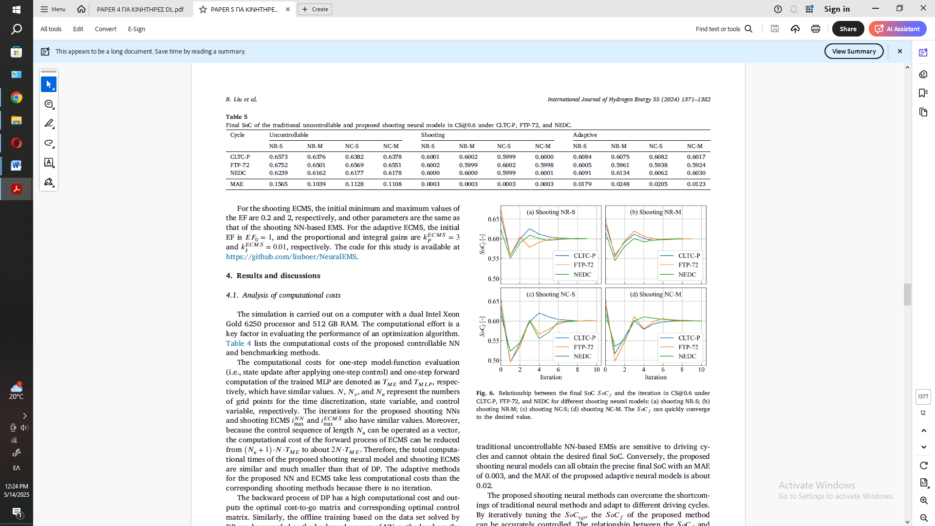
COMPARISON OF THE MODELS

Slide 33
COMPARISON OF THE MODELS
Table 5 shows that:
Traditional models fail to control the SoC.
The shooting neural networks achieve nearly perfect accuracy.
The adaptive NC-M achieves the best compromise between accuracy and adaptability, performing better in realistic conditions.

Slide 34
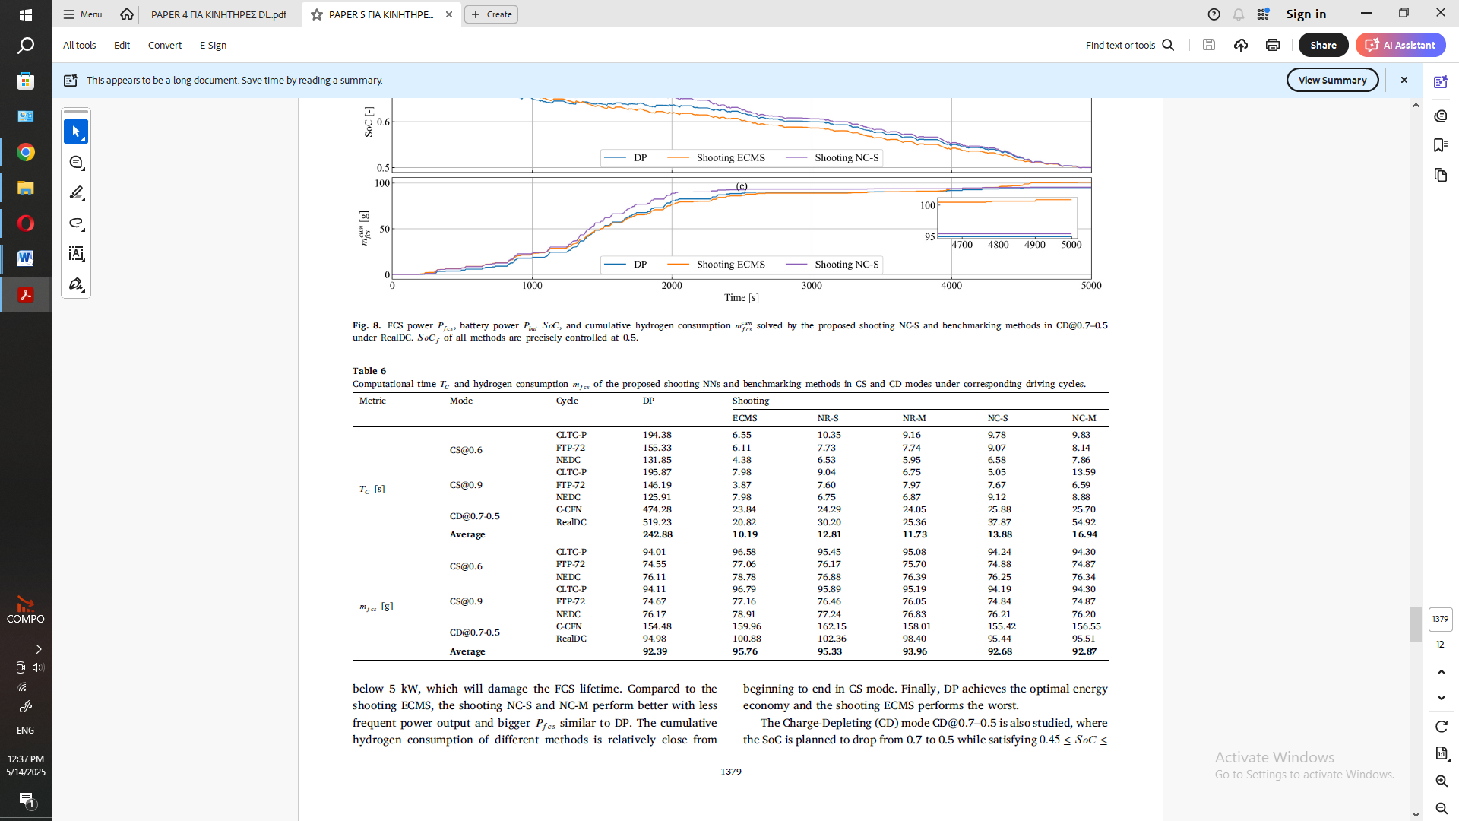
COMPARISON OF THE MODELS

Slide 35
COMPARISON OF THE MODELS
The table 6 shows that the Shooting and Adaptive neural models (especially NC-M):
Accurately approximate the performance of Dynamic Programming
Have dramatically lower computational cost
Are suitable for real-time use in FCEVs

Slide 36
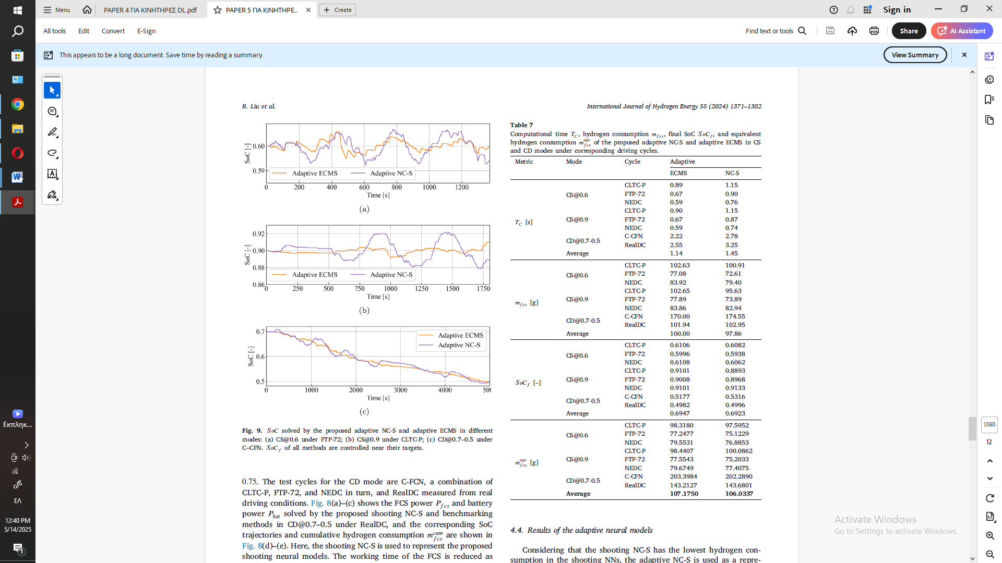
COMPARISON OF THE MODELS

Slide 37
COMPARISON OF THE MODELS
Table 7 from Paper 5 presents a comparison between two adaptive EMS methods (Adaptive ECMS and Adaptive NC-S) in terms of:
Four key performance indicators:
Indicator | Description
Tc [s] | Computation time
mfcs [g] | Hydrogen consumption
SoCf | Final battery state of charge
mfcs equ [g] | Equivalent hydrogen consumption (normalized)

Slide 38
COMPARISON OF THE MODELS
Table 7 shows that the Adaptive NC-S:
1) Is fast (1.45 s) making it suitable for real-time use
2) Achieves the same or better SoC and hydrogen consumption
3) Outperforms the Adaptive ECMS in terms of consumption and efficiency making it an ideal choice for adaptive EMS in FCEVs

Slide 39
COMPARISON OF THE MODELS
This paper introduces the concept of controllable neural networks for optimal energy management in fuel cell hybrid electric vehicles (FCHEVs).
It develops two methods:
A shooting method for known driving cycles
An adaptive method for real-world driving conditions.
These approaches enable real-time control of the neural network output without altering network parameters, using the battery SoC target as a key tuning element—similar to the equivalence factor in ECMS.
Simulation results highlight:
High adaptability and state constraint control
Shooting networks offering over 3% fuel savings with comparable computation time to ECMS
A ~95% reduction in computational cost with minimal performance loss (0.3% compared to Dynamic Programming)
Adaptive networks delivering better fuel economy than adaptive ECMS
While promising, the proposed controllable neural network approach is still in the early stages of development and refinement.

Slide 40
Deep stochastic reinforcement learning-based energy management strategy for fuel cell hybrid electric vehicles
Scientists: Basel Jouda , Ahmad Jobran Al-Mahasneh , Mohammed Abu Mallouh
This study proposes a deep stochastic reinforcement learning approach—deep REINFORCE—to enhance the energy management of fuel cell hybrid electric vehicles (FCHEVs). Incorporating a deep neural network baseline and entropy regularization, this method addresses the challenge of limited training data and epistemic uncertainty. Validated using the New York City and Amman driving cycles, the proposed approach improves fuel economy by up to 13.53% compared to traditional EMS strategies like DDQN, PFC, and FLC, while also reducing training time by 38%. Overall this deep REINFORCE-based EMS not only delivers superior fuel economy but also demonstrates improved handling of epistemic uncertainty.

Slide 41
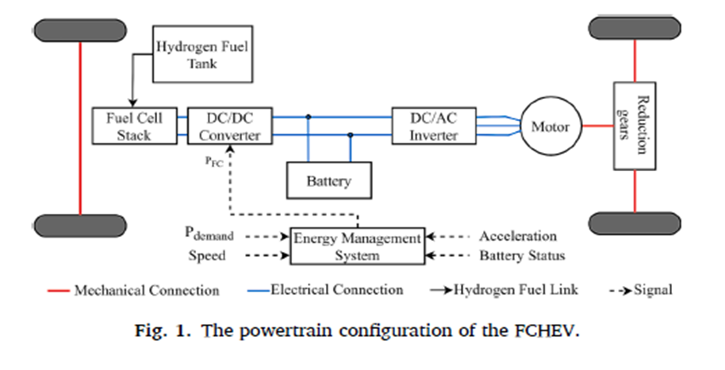
POWER TRAIN CONFIGURATIONS OF THE FCEV

Slide 42
POWER TRAIN CONFIGURATIONS OF THE FCEV
What the system includes:
1) Hydrogen Fuel Tank → stores hydrogen
2)Fuel Cell Stack (FC) → generates electricity from hydrogen
3) DC/DC Converter → regulates power from the fuel cell to the battery and system
4)Battery → stores or provides energy depending on the scenario
5)DC/AC Inverter → converts the current for the motor
6)Motor → drives the wheels
7)Final Drive & Wheels → final power transmission to the wheels
8)Reduction Gears reduce the high RPMs of the electric motor and increase torque to the wheels, ensuring efficient and smooth power transmission in the FCHEV.
Connections shown (with lines):
1) Red (Mechanical Connection) → from motor to drivetrain
2) Blue (Electric) → electrical power transfer between components
3) Black (Hydrogen Fuel Link) → hydrogen to the fuel cell
4) Dashed (Energy Management System) → the EMS that decides which energy source to use

Slide 43
DIAGRAM OF INTERACTION RL CONTROLLER WITH THE FCEV (ENVIRONMENT)

Slide 44
DIAGRAM OF INTERACTION DEEP REINFORCE BASED-EMS WITH THE FCEV

Slide 45
DIAGRAM OF INTERACTION DDQN BASED-EMS WITH THE FCEV

Slide 46
DATA THAT THEY USED FOR TRAINING
Four driving cycles were selected for training and validating the developed deep reinforcement learning-based EMSs (deep RL-based EMSs).
The Urban Dynamometer Driving Cycle (UDDS) and the Highway Fuel Economy Test (HWFET).
These were chosen to cover both urban and suburban driving characteristics.
The validation cycles—the New York City Cycle (NYCC) and an experimental driving cycle for the city of Amman, developed by Mallouh et al. [40].
The UDDS, HWFET, and NYCC are standardized cycles from the Environmental Protection Agency (EPA).
The inclusion of the Amman cycle ensures the generalizability of the EMS based on deep REINFORCE.

Slide 47
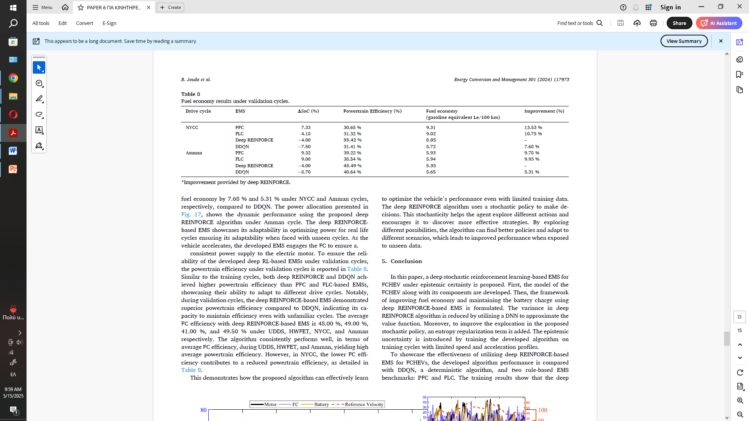
EMS COMPARISON
The Table 8 below presents the fuel economy results of the various EMS systems on validation cycles.

Slide 48
PAPER CONCLUSION
This study proposes a deep stochastic reinforcement learning-based EMS (Deep REINFORCE) for FCHEVs under epistemic uncertainty.
The system:
1) Uses a DNN to reduce algorithm variance
2) Adds entropy regularization for better exploration
3) Handles limited training data from low-speed driving cycles
Key findings:
1) Reduced training time by 38% vs. DDQN
2) Achieved 7.68% and 5.31% better fuel economy in NYCC and Amman cycles
3) Consistently outperformed rule-based systems (PFC, FLC)
4) Stochastic policy enables more diverse action exploration for superior performance in unseen conditions

Slide 49
Energy management of fuel cell hybrid electric bus in mountainous regions: A deep reinforcement learning approach considering terrain characteristics
Scientists: Tianfeng Tang, Qianlong Peng, Qing Shi, Qingguo Peng, Jin Zhao, Chaoyi Chen, Guangwei Wang
This study introduces an innovative energy management strategy (EMS) for fuel cell hybrid electric buses (FCHEBs) in mountainous areas, using a deep reinforcement learning (PPO) algorithm that accounts for challenging terrain characteristics.
A comprehensive model representing steep slopes and road fluctuations was developed, and real driving data from these regions were collected for training. Simulation results show a 26.16% improvement in fuel economy and 44.98% faster convergence compared to traditional methods.
Further tests on new bus routes and standard driving cycles confirm the strategy’s robustness and adaptability.

Slide 50
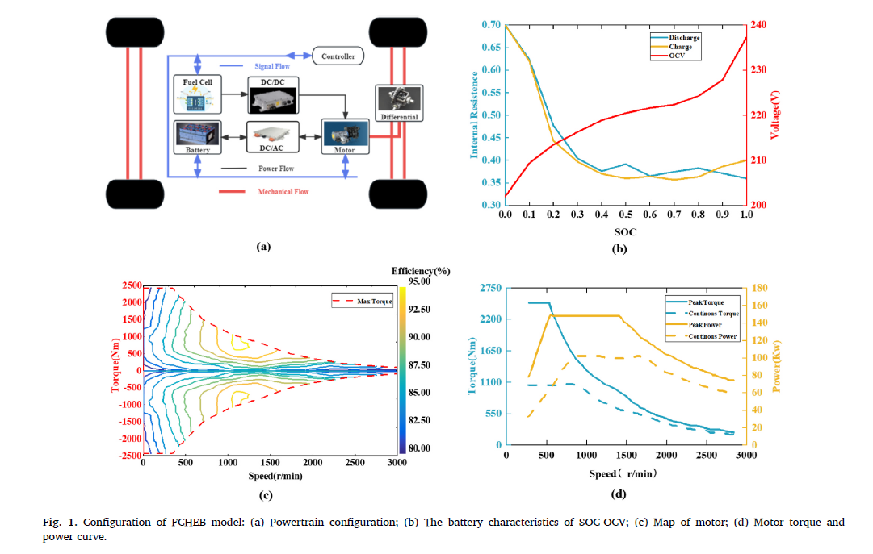
POWERTRAIN SYSTEM MODELING OF THE FCEB

Slide 51
POWERTRAIN SYSTEM MODELING OF THE FCEB
Figure 1 summarizes the FCHEB model used in the Paper.
It includes:
The power and signal flow within the vehicle
Battery characteristics in relation to SOC
Motor performance and limits based on torque, power, and RPM.
These details are essential for the training and evaluation of the EMS with DRL.

Slide 52
DATA THAT THEY USED FOR TRAINING AND TEST
Data Summary:
1) The China City Bus Cycle (CCBC) was used as the initial reference framework.
2) Real-world speed and road slope data were collected from a bus route in Guiyang, China.
3) The data collection was performed using an RTK (Real-Time Kinematic) device and GPS from 7:00 a.m. to 9:00 p.m. for one week.
4) The route included 31 stops on the outbound journey (32.6 km) and 25 stops on the return trip (29.9 km).
5) Tools such as Digital Elevation Model (DEM) and ArcMap were used for elevation data analysis.
6) Data cleaning was conducted using:
Smoothing (moving average)
Interpolation for missing data
Resampling to 1-second intervals
Normalization of accelerations, decelerations, etc.
7) Why this was done:
The unique characteristics of mountainous areas with steep slopes require specialized training data that capture these conditions, so the EMS can become adaptive and efficient in such terrain.

Slide 53
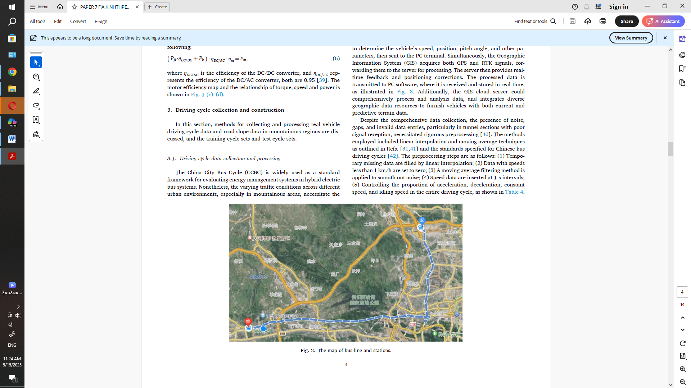
DATA THAT THEY USED FOR TRAINING AND TEST
The Figure 2 shows the map of the bus route and its stops and is directly related to Chapter 3.1 “Driving cycle data collection and processing,” which describes the collection of real-world data for training the EMS.

Slide 54
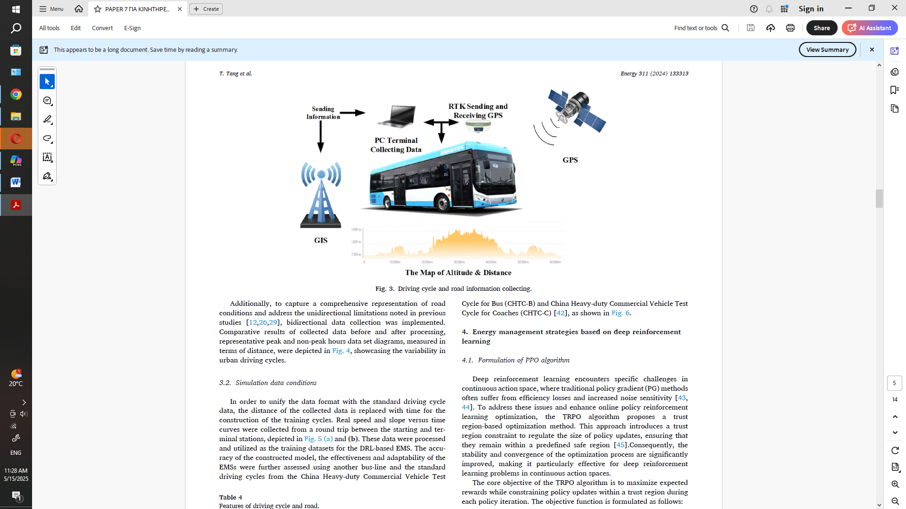
SYSTEM THAT THEY USED FOR TRAINING AND TEST
This is a flowchart of the data collection process from the bus and is related to the implementation described in Chapter 3.2 of the Paper.
A hydrogen-powered bus is equipped with:
1) High-accuracy RTK-GPS receiver
2) PC terminal for data collection
3) GIS connection for map data integration
4) Data upload to a server or transmission to a GIS station
5) At the bottom of the figure, there is an Elevation–Distance graph, which corresponds to the ~60 km route whose data is used for training and testing.

Slide 55
DATA THAT THEY USED FOR TRAINING AND TEST
The dataset was obtained from GPS, RTK, and GIS collection, as shown in the figure 3 before.
The Elevation, distance, speed, and acceleration were recorded every second.
The data was divided into:
Training set: 0–40 km
Testing set: 40–60 km
Filtering/cleaning was also performed using moving average & padding.

Slide 56
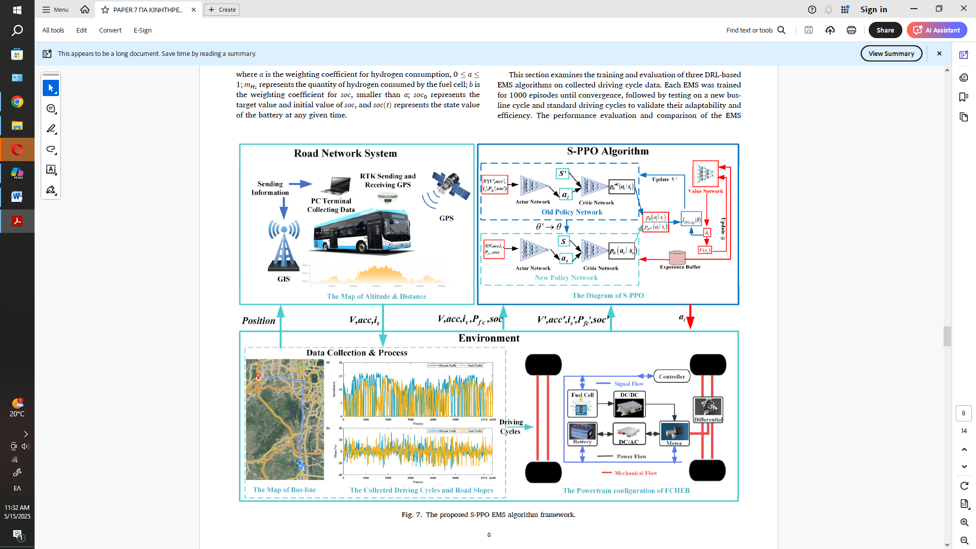
DATA THAT THEY USED FOR TRAINING AND TEST

Slide 57
DATA THAT THEY USED FOR TRAINING AND TEST
The Figure 7 of the Paper that we saw before is an overall framework diagram that illustrates how the proposed energy management system (EMS) operates using a modified Proximal Policy Optimization algorithm (S-PPO) in a fuel cell hybrid electric bus (FCHEB).
Data flow:
From the real-world route (GPS), position, speed, and slope points are extracted.
These are converted into states and sent to the S-PPO algorithm. The algorithm decides on the action aₜ (e.g., fuel cell power).
The action is applied to the FCHEB model resulting in a new state.
Figure 7 illustrates the entire architecture of the S-PPO EMS system. From data collection on the actual bus to decision-making via deep reinforcement learning and application to the FCHEB powertrain.
It links Chapters 2 (Modeling), 3 (Data Collection), and 4 (PPO Algorithm).

Slide 58
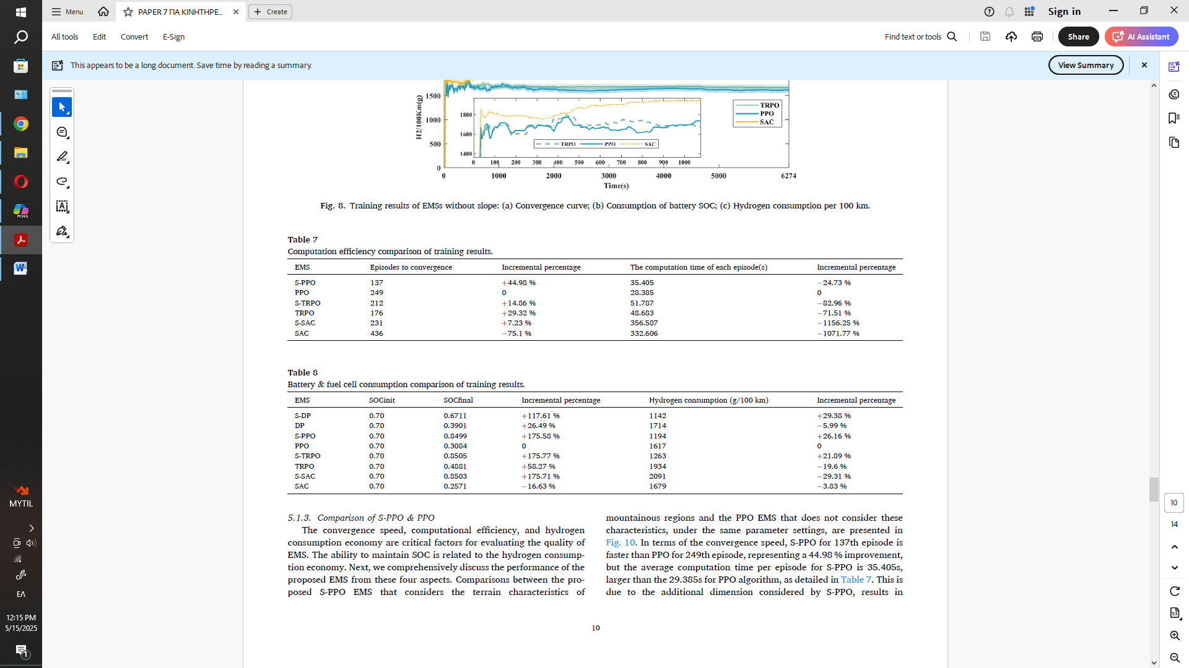
RESULTS OF THE TRAINED ALGORITHMS

Slide 59
RESULTS OF THE TRAINED ALGORITHMS

Slide 60
RESULTS OF THE TRAINED ALGORITHMS

Slide 61
RESULTS OF THE TRAINED ALGORITHMS
Evaluation of EMS Algorithms (Chapter 5.1)
Evaluated: S-PPO, S-TRPO, S-SAC (terrain-aware variations)
Key Results (Fig. 9 & Tables 7–8):
S-PPO: Converges in 137 iterations (44.98% faster than PPO), best fuel economy: 1194g H₂/100km
S-TRPO: 231 iterations, 4.27% higher consumption
S-SAC: 212 iterations, 55.48% higher consumption
SOC target (0.85) maintained due to regenerative braking
Training time per episode:
S-PPO: 35.4s
S-TRPO: 51.8s
S-SAC: 356.6s
S-SAC struggles in complex environments despite entropy regularization
Conclusion:
S-PPO outperforms in learning speed, fuel economy, and SOC stability – the optimal EMS for mountainous terrain.

Slide 62
RESULTS OF THE TRAINED ALGORITHMS

Slide 63
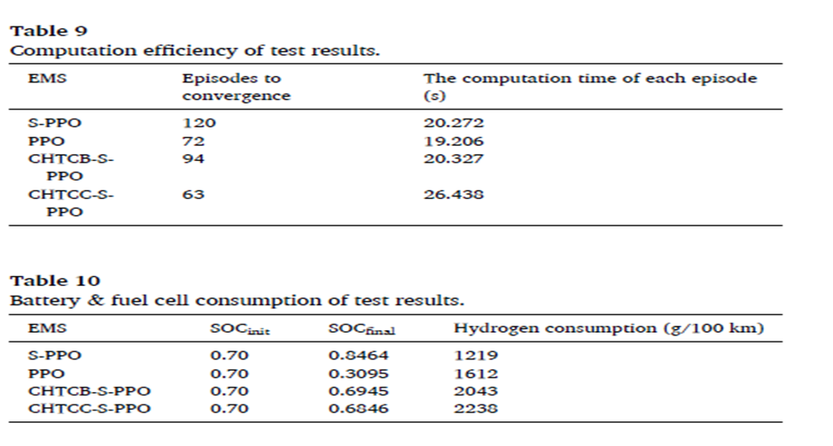
RESULTS OF THE TRAINED ALGORITHMS

Slide 64
RESULTS OF THE TRAINED ALGORITHMS
For further evaluation of the adaptability and computational efficiency of the S-PPO-based EMS the CHTC-B and CHTC-C driving cycles were used for testing.
Due to the absence of standardized road slope data, a uniform slope value of 3% was applied during validation.
The results are presented in Tables 9 and 10.
As shown in Table 9: The average computational time per episode was 20.327s and 26.438s respectively—both lower than that of S-PPO (35.405s).
Convergence efficiency also improved significantly, with convergence at the 94th and 63rd iterations, respectively.
These results demonstrate the strong adaptability and computational efficiency of the proposed EMS.
However, due to the lack of terrain information and insufficient energy recovery via regenerative braking, most of the energy came from the power system (fuel cell), leading to high hydrogen consumption:
2043 g/100 km (CHTC-B)
2238 g/100 km (CHTC-C)(as shown in Table 10)
Nevertheless, the battery—acting as an auxiliary energy source—maintained stability, with SOC remaining close to the initial value.

Slide 65
CONLUSION
This study introduces a terrain-aware deep reinforcement learning EMS (S-PPO) for fuel cell hybrid buses in mountainous regions.
Key features of S-PPO:
Accounts for road slopes, SOC, and H₂ consumption
Achieves +44.98% faster convergence, −26.16% hydrogen use, and +175.58% higher final SOC vs. PPO
Confirmed robust performance and adaptability on new bus routes
Conclusion:
S-PPO is the optimal EMS for challenging mountain environments!

Slide 66
EXPERIMENT
For the purpose of my presentation I create from scratch a machine learning system that helps an EMS system recognize whether the combination of system states is good or bad.
The programming language I used to train my models was Python.
The models that I used were not pretrained and all the results are not connected to reality and are simply for educational purposes.

Slide 67
EXPERIMENT’s DATA CREATION
I tried to create a small virual dataset with the help of ChatGPT.
First, I explained to ChatGPT what I wanted to do and then I provided ChatGPT with the column names I wanted and it generated imaginary numbers to create a dataset representing virtual states of an FCHEV system.
The parts of the virtual dataset are:
Speed (km/h): Vehicle speed affecting power demand.
Weight (kg): Heavier load => higher energy needs.
Temperature (°C): Affects Fuel Cells & battery efficiency.
Road Inclination (%): Slopes impact power and regenerative braking.
Hydrogen Consumption (kg/100km): Key fuel economy indicator.
State of Charge (SOC) (%): Battery health & readiness.
Battery Power (kW): Energy flow direction (assist or recharge).
Battery Temp (°C): Battery safety & performance.

Slide 68
EXPERIMENT’s DATA CREATION
The most important thing in a dataset is the TARGET.
The Target Column Indicates the system state:
0 = as a Good condition
1 = as a Bad condition
Serves as the output label for classification models.
Trains the models to recognize whether the combination of features describes a good or bad state of the FCHEV system.

Slide 69

EXPERIMENT’s DATA CREATION
Here is a sample of the dataset that I created with the help of ChatGPT:

Slide 70
EXPERIMENT’s DATA CREATION
Good states (0) - e.g., Rows 1, 5, 6, 7, 11:
SOC & hydrogen consumption within normal range
Battery temperatures safe (e.g., Row 1: 18.33 °C, Row 6: 39.65 °C)
Balanced battery power (e.g., Row 6: -33.74 kW => regenerative charging)
Bad states (1) - e.g., Rows 2, 3, 4, 8, 9, 10:
Very high SOC (e.g., Row 2: 96.06%) or very high battery temperature (e.g., Row 3: 49.28 °C)
Excessive hydrogen consumption (e.g., Row 9: 16.17 kg/100 km)
High/unstable battery power (e.g., Row 9: 44.98 kW → system strain)

Slide 71
CODE CREATION
The Chapters of our code are:
Import of the basic python libraries for this work:
Reading the file with the target
Defining characteristics and goal
Model definition
Training and evaluation with cross-validation and confusion matrix storage
Create a folder to store images
Visualization and storage of confusion matrix
Overall scoreboard
Visualization of overall results

Slide 72
CODE CREATION
The important Chapters of our code are:
3) Defining characteristics and goal:
80% of the dataset for training
20% of the dataset for testing
4) Model definition:
Random Forest, Naive Bayes, K-Nearest Neighbors, Logistic Regression, Support Vector Machine
5) Training and evaluation with cross-validation and confusion matrix storage

Slide 73
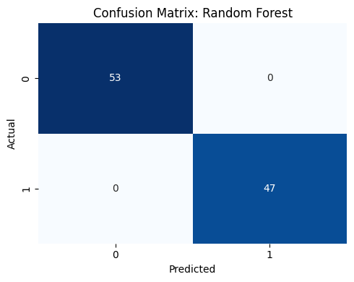
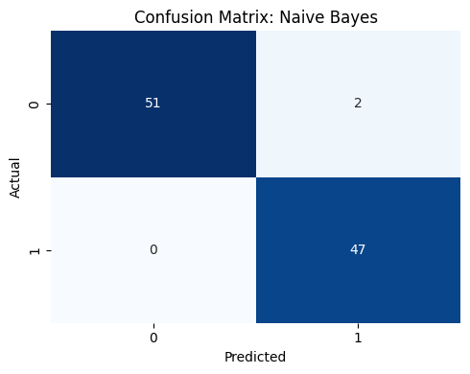
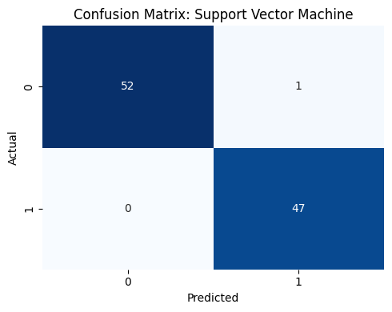
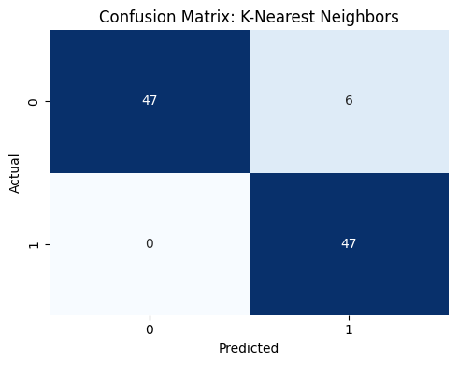
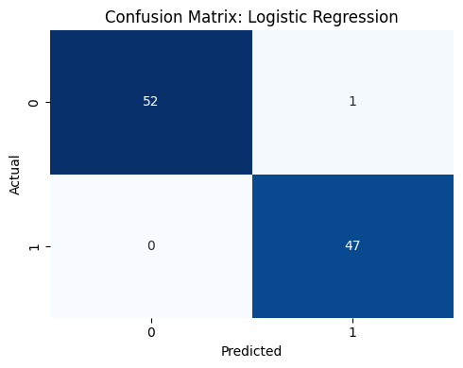
RESULTS OF MY EXPERIMENT

Slide 74
CLASSIFICATION RESULTS ANASLYSIS BY ALGORITHM
Random Forest: The model performed perfectly (Accuracy = 100%), correctly predicting all 53 positive (class 0) and 47 negative (class 1) cases. There are no false positives or false negatives. Ideal for this dataset.
Support Vector Machine (SVM): It had 1 error in class 0 (1 false positive), but correctly classified all negative cases. Very good accuracy Accuracy = 99% with excellent ability to distinguish between the two classes.
Naive Bayes: It had 2 errors in class 0 (false positives) but no errors in class 1. Excellent performance for such a simple model Accuracy = 98%. Slightly more prone to false positives.
K-Nearest Neighbors (KNN): Predicted all negative cases correctly but made 6 errors in category 0. Increased false positives, with Accuracy = 94%. Possibly affected by the distribution or scale of the features.
Logistic Regression: Compared to SVM, only 1 false positive appeared in category 0 with Accuracy = 99%. Balanced and reliable performance for a linear classifier.
Overall Conclusion: All models had excellent performance, with Random Forest standing out as the most accurate. Small deviations appeared mainly in false positives (category 0) which is important in environments where preventing falsely safe states is critical.

Slide 75
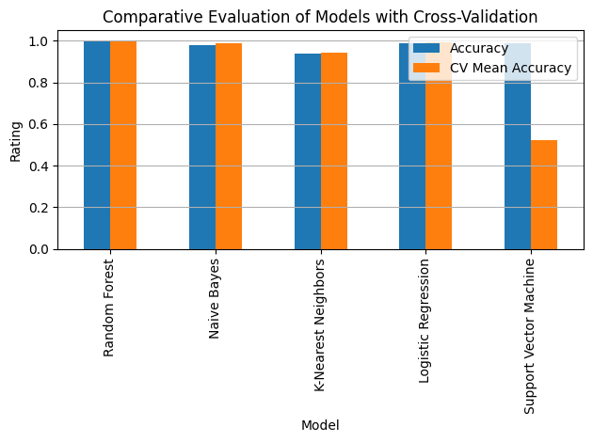
RESULTS OF MY EXPERIMENT

Slide 76
COMPARATIVE MODEL EVALUATION WITH CROSS-VALIDATION
The following column shows the comparative performance of our machine learning models based on two metrics: accuracy on the control dataset (Accuracy) and the average accuracy during the cross-validation process (CV Mean Accuracy):
Random Forest:
It achieved excellent performance in both test and cross-validation, showing high generalization and reliability.
Naive Bayes:
Very good accuracy in both metrics demonstrating that despite its simplicity it can be efficient for binary classification problems.
K-Nearest Neighbors:
It shows slightly lower values ​​compared to the other models probably due to sensitivity to outliers or the need to optimize k.
Logistic Regression: High performance both in test and CV confirming the stability of linear models on well-separated data.
Support Vector Machine (SVM):
Despite having high accuracy on the test set the average value from cross-validation is significantly lower indicating possible overfitting or sensitivity to the data distribution.
Conclusion:
Random Forest emerged as the most reliable and stable model while the other models showed good to very good performance, with some fluctuations in generalization. The diagram supports the correct model selection based on overall behavior and not just individual metrics.

Slide 77
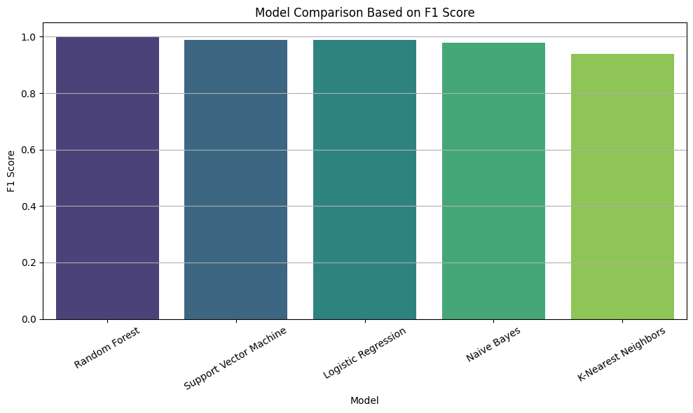
RESULTS OF MY EXPERIMENT

Slide 78
RESULTS OF MY EXPERIMENT
The “Model Comparison Based on F1 Score” table shows us the performance of our machine learning algorithms based on the F1 Score an important metric that combines precision and recall.
Comments:
Random Forest: Achieved the highest F1 score (~1.0) which indicates excellent accuracy and recognition of both classes (0 and 1) with almost no errors.
Support Vector Machine & Logistic Regression: Very high scores (~0.99) showing excellent performance with minimal errors. They are particularly reliable algorithms in binary classification.
Naive Bayes: Also close to 0.98 showing that it handles your dataset well despite being a model with fewer assumptions.
K-Nearest Neighbors (KNN): Has the lowest F1 score (~0.94) but remains very satisfactory. KNN is often sensitive to parameters such as the choice of “k” or the scale of the features.
Conclusion:
Random Forest showed the best balance between precision and recall while all algorithms achieved very high performance. KNN was the “weakest” but still shows reliable behavior. The F1 comparison shows that the models are suitable for accurate classification in this problem.

Slide 79
EXPRERIMENT INSIGHTS & FUTURE PERSPECTIVES
The dataset contains only 500 rows which is relatively small for high-accuracy predictions, but it provides a solid foundation for experimentation.
The structure and features of the dataset are particularly useful for developing an Energy Management System (EMS).
This experiment offered a clear and practical overview of the machine learning training cycle in the context of energy systems.
The code used is fully functional and scalable ready to be applied to larger and more accurate datasets in future research.

Slide 80
POTENTIAL FUTURE ML APPLICATIONS IN EMS
Anomaly Detection (e.g., excessive consumption, voltage drops, poor fuel cell performance)
Real-Time Decision Making (e.g., switching between fuel cell and battery sources)
Predictive Maintenance (e.g., detecting improper operation before a failure occurs)

Slide 81
CONLUSIONS
There are some serious issues that scientists have faced with the datasets:
1) Noise & Data Gaps (PAPER 4th)
- Weak GPS, measurement errors => need for interpolation, normalization and filtering.
2) Limited Variety (PAPER 2nd)
- Few data covering specific conditions (SoC, cycles, environment).
3) Sensitivity in Validation Sets (PAPER 1st & 3rd)
- More realistic data collection is needed.
- Large computational resources & sensitivity to “unknown” data.
What We Learn:
Realistic and rich datasets are critical for the success of an EMS system – especially when based on ML!

Slide 82
CONLUSIONS
What We Achieved:
Validated the potential of advanced EMS algorithms in FCHEVs for real-world driving and terrain conditions.
Improved fuel economy and faster convergence (up to 26% savings, 45% faster learning).
Our small-scale ML experiment with synthetic data demonstrated how data-driven models can distinguish good and bad system states.
Highlighted the usefulness of features like SOC, H₂ consumption, and battery temperature for anomaly detection and operational safety.
What’s Needed in the Future:
Integration of real-world, high-quality datasets to replace synthetic data.Expansion of training data to include more diverse driving cycles and environmental conditions.
Combine physics-based models with ML for even more robust EMS performance.
Real-time deployment in FCHEVs to support dynamic energy source switching and predictive maintenance.
This research and our ML experiment underscore the power of modern algorithms in enhancing fuel cell vehicle performance. Moving forward, we’ll need richer data and real-world testing to unlock the full potential of AI-driven energy management systems.

Slide 83

THANK YOU

